Slide 1
U STORIES: Oral History and Urban Experiences
Case of the Center for Urban History
Archival Project
Natalia Otrishchenko

Slide 2
Institutional Context
Center was founded in 2004 as a private non-profit research and academic organization committed to non-material aims
interdisciplinary research organization (historians, sociologists, art historians, geographers, architects, and IT-specialists)

Slide 3
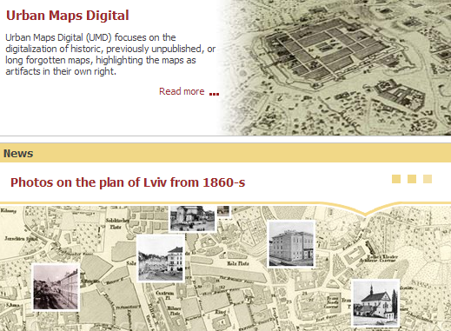
Activities
Research projects
Exhibitions
Summer schools
International conferences
Seminars
Public discussions
Presentations

Slide 4
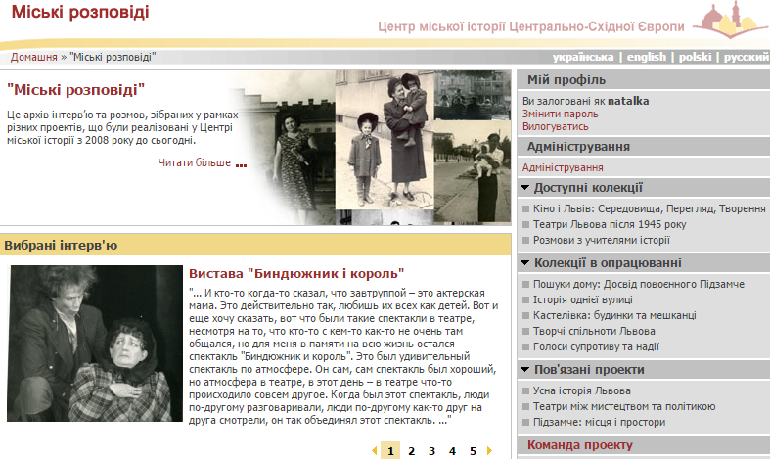

Slide 5
U Stories Project
Collections:
experiences connected with place of living (oral history of city districts)
experiences connected with area of activities (professional live)
collection of interviews with participants of EuroMaidan in Kyiv, Lviv, and Kharkiv
Focus groups with history teachers

Slide 6
U Stories Project
Criteria for organizing collections:
(1) topic and origin (relation to the project);
(2) methodology (general logic of the research, aims, hypotheses, specifics of the sample and questionnaire);
(3) procedure (terms of realization of field stage, one group of interviewers, coordinator).

Slide 7
U Stories Project: Methodology
Oral history (narrative / biographical)
In-depth semi-structured thematic interviews
Qualitative sociological tradition (interviews, focus group discussions)

Slide 8
U Stories Project
Qualitative interviews and oral history were used as methods of understanding and identifying:
how communities create and maintain their own vision of the past
how people deal with their social and individual identities
how people experiences their home and city in general

Slide 9
U Stories Project: Access
Description of collection available on-line, transcripts and audio only after registration:
Request form
Signing informed consent with researcher
Norms from Ethical Codex and Ukrainian legislation
Question of editing audio and transcripts

Slide 10
Ethical Issues
Work in all contexts (macro, meso, and micro) and on every stage of the research
General Rules: Codes of professional Ethics
Importance of informed consent: with an informant and with a researcher

Slide 11
Future perspectives
make history more personal,
raise different perspectives,
answer to the monolithic view of the past,
see how people live through different historic periods,
reveal the difference between macro level of historical narratives of the state and institutions and a micro level of personal stories.

Slide 12
For more information see
http://www.lvivcenter.org/uk/ust/
or e-mail: n.otrishchenko@lvivcenter.org

