Slide 1
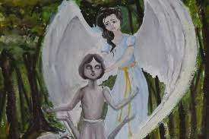
The confession of angel
(The chronicle of another’s pain)

Slide 2
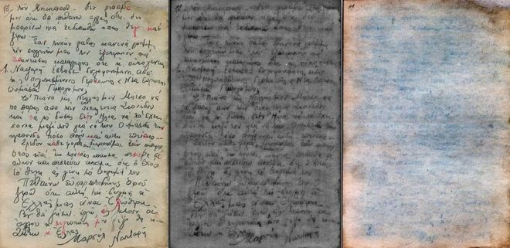
History of one Jewish life
one of millions ...
Thanks to the little twisted pieces of paper in a hidden bottle,
she became known to us, not indifferent , because we needed the truth,
But had known about it,
we were able to rate all the infinite torment and despair,
learn that we need to love our life ...

Slide 3
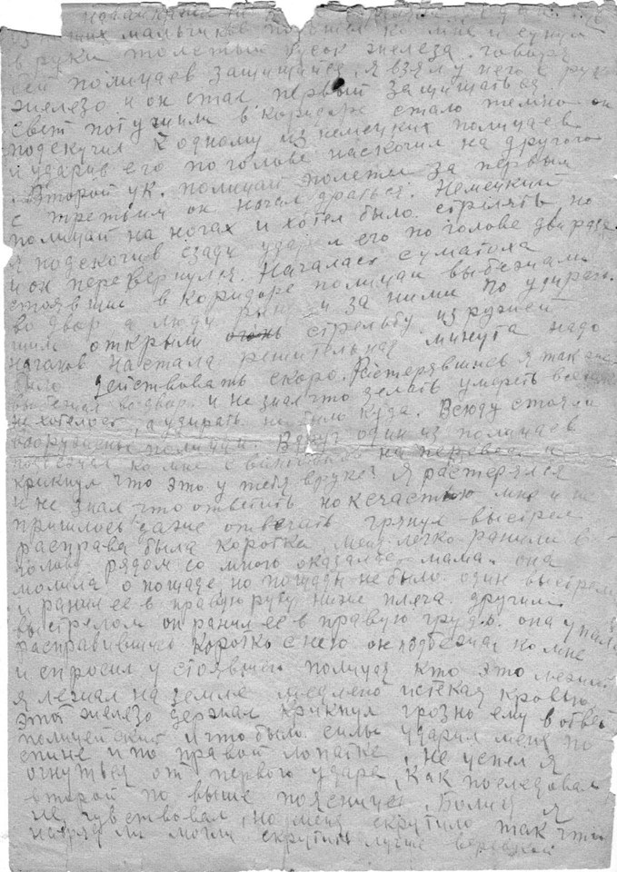
The source of the work is the diary of Joseph Butovetsky's Jewish boy 1941-1949 - one of many documentary evidence of the genocide of Jews in the Kirovograd region.

Slide 4
It is said that immediately after the birth of a child in the sky a new star flares up to the moment of human death. Star of Joseph was proclaimed on April 25, 1928, when to the family of Mary and Jacob Butovetsky came happiness - their son. He was an eighth child in this family. In the future, he was destined to go through the occupation of his native city, prosecution of hiding, the ghetto, and then transfer it to the pages of the diary, so that future generations could find out the terrible truth of those days of terror.
Often life is limited to testimony
about birth
Sergey Zhadan

Slide 5
.
The story reveals the previously concealed by history aspects of the tragedy, which took place on the territory of our native land.
This promotes awareness not only of the fact that the Holocaust took place in the central Ukrainian region, but also allows to think about its true scale.

Slide 6
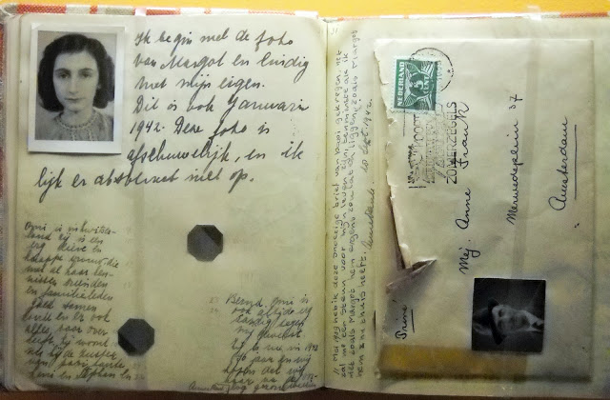
The diary of Joseph Butovetsky was written in 1941, before the diary of Anna Frank. Different countries, different people, similar destinies. At the time of Holocaust, they were not sacrifices, they were the fighters, who desperately believed that their notes will be found by relatives, that their notes could describe the creepy days of systematic extermination of Jews.

Slide 7
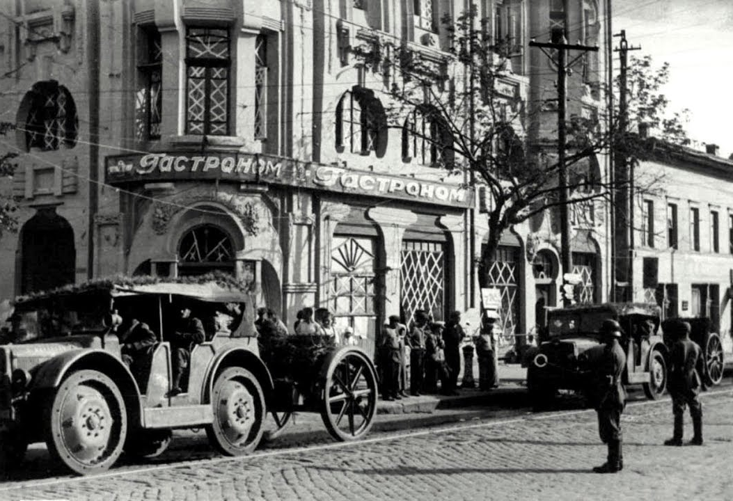
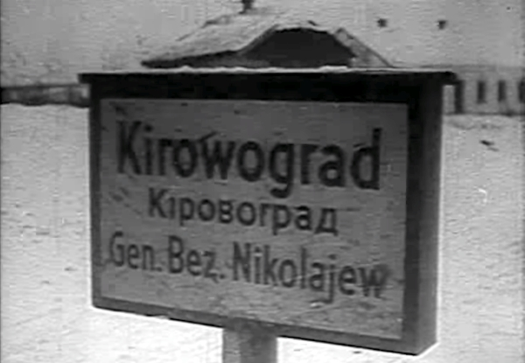
During the occupation of Kirovohrad by the Nazis, the Butovetsky family became one of the many million victims of the Holocaust. After the father was taken in August 1941 for public works (according to the official version), Joseph and his mother remained at their neighbors until spring, Anna and Semen Chernov, who, despite the threat of shooting, hid Jews at home.

Slide 8
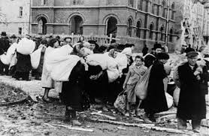
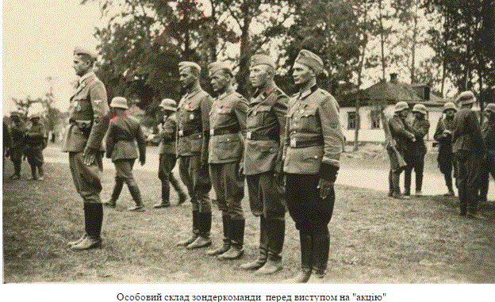
However, despite the strict conspiracy, because of that they were noticed by accidental passers-by through the open window, they were forced to move to the Zlatopil Ghetto, where they were for four months, until all those who were there at that time were taken to the shooting.

Slide 9
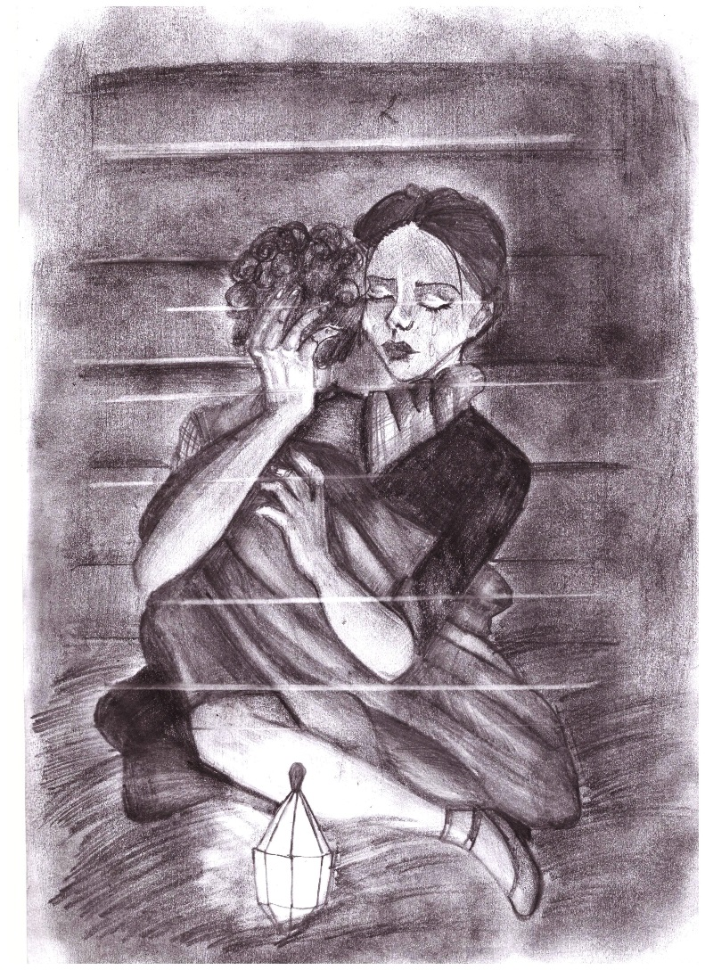
Joseph managed to escape. Of course, we can say that he was lucky because he could go unnoticed to Chernov’s. However, he came to Kirovograd alone. His dead mother stayed in Zlatopil

Slide 10
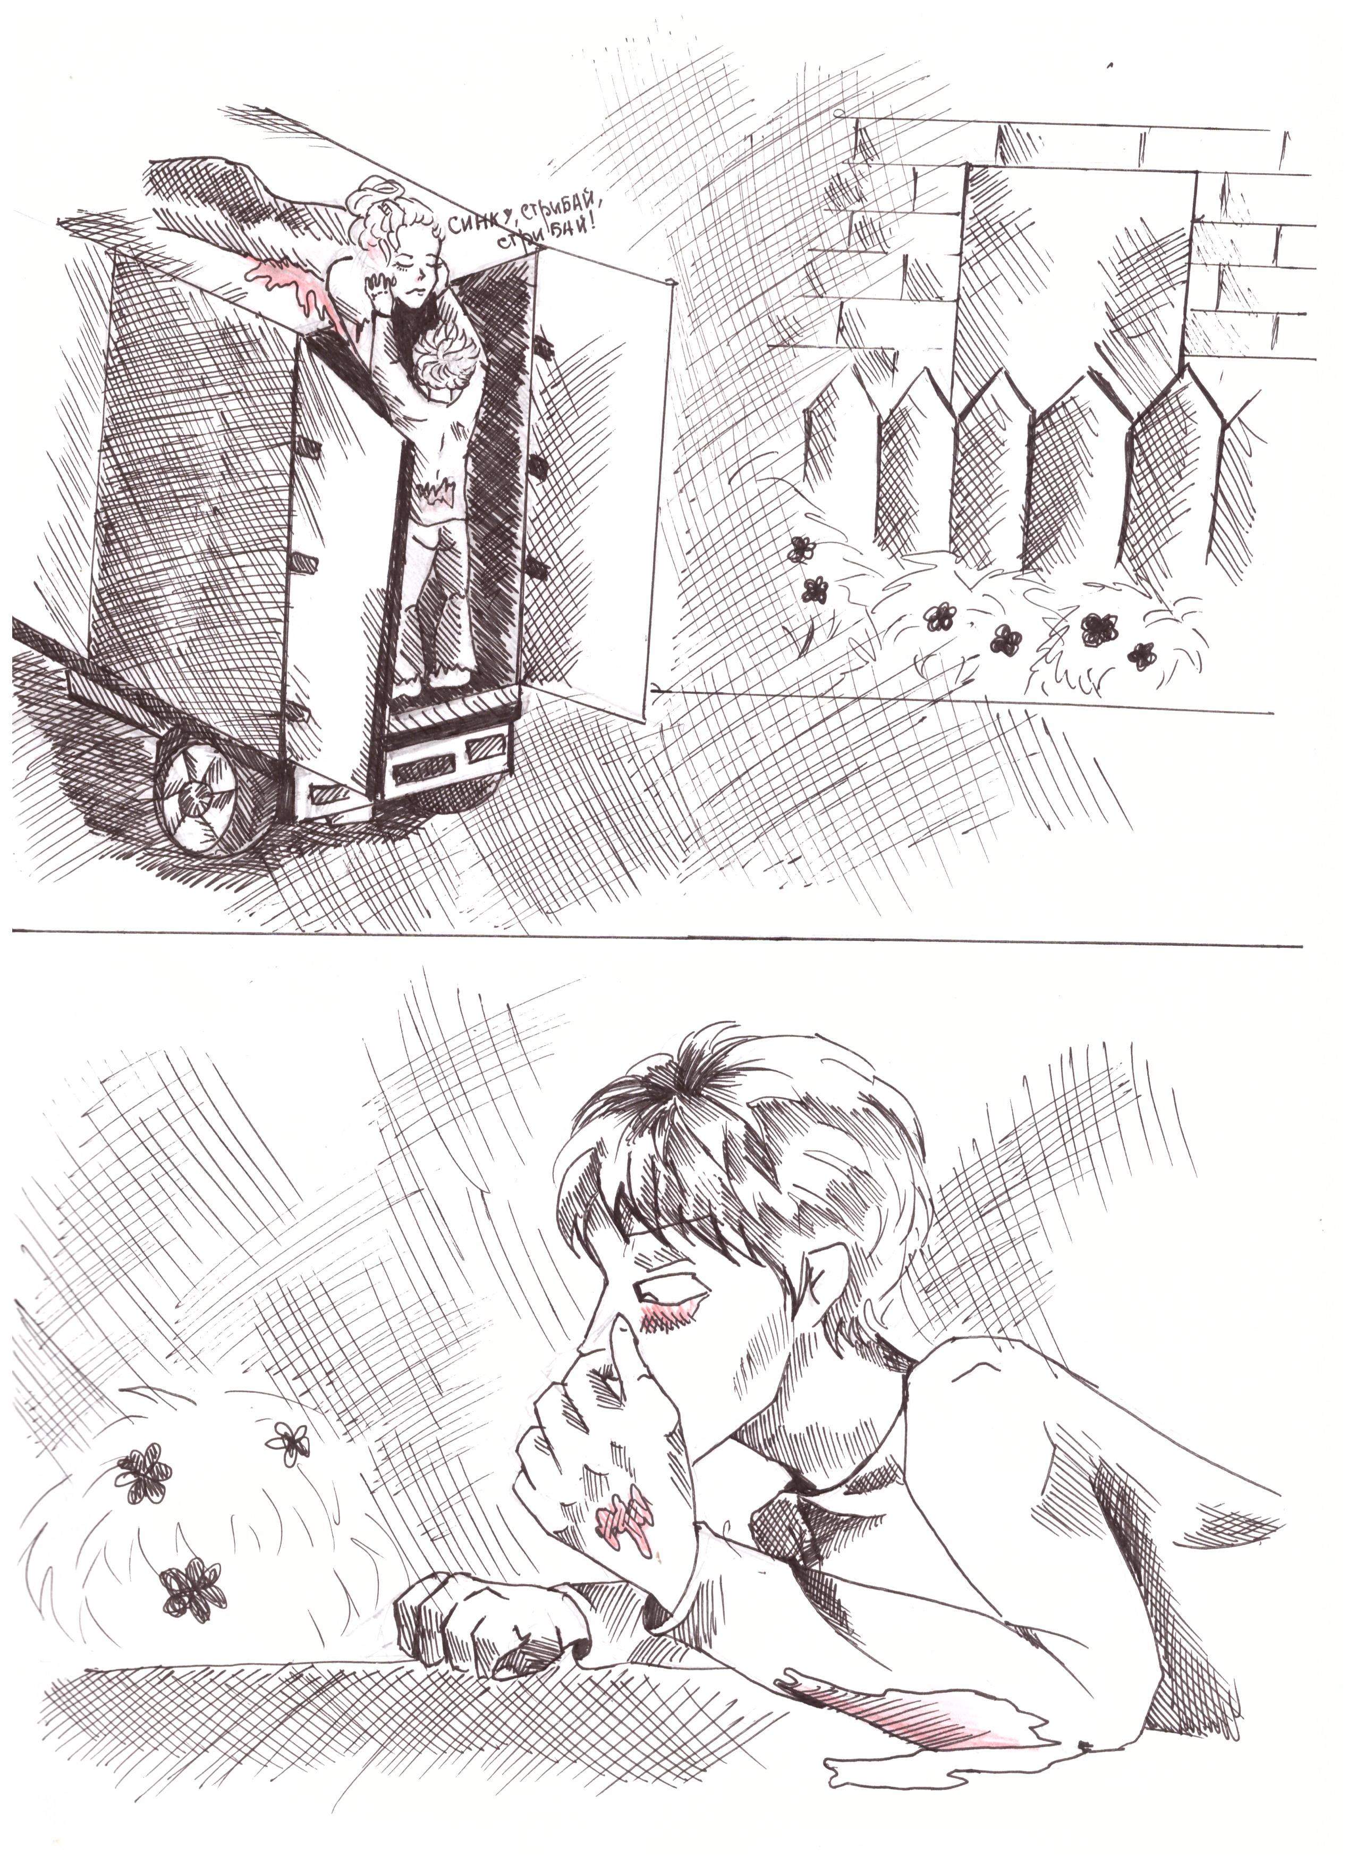
His life did not last long. When he tried to cross the front line, he perished in the hands of Nazis.

Slide 11
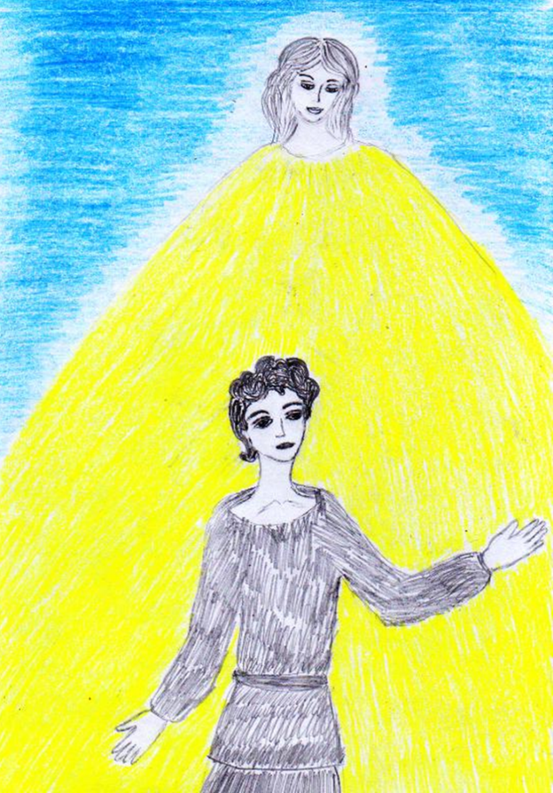
Throughout his life, Joseph had a faithful friend and invisible companion for him - an angel guard.

Slide 12
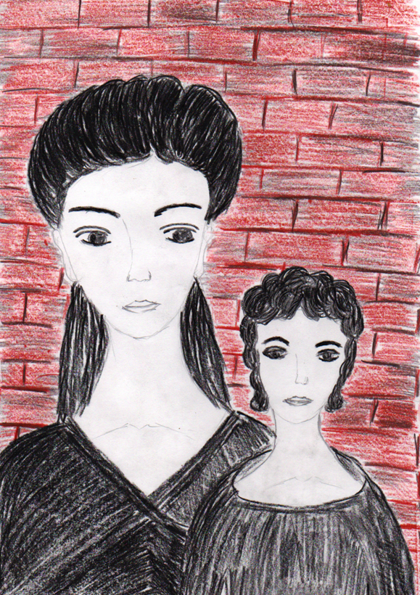
"Confession of the angel" is a somewhat contradictory combination of words, because the angels in their essence are supernatural immaculate creatures, but not sinners. They are mediators between men and God, in some sense saints. But in our case the angel repents not for his actions, but for those, whom he has guarded ...

Slide 13
What does the angel confess? Is his penitential tear cleansing? This is exactly that case when every reader will discover something personal for himself, because the confession is an intimate and sacred process, as well as a cleansing tear of catharsis ...

Slide 14
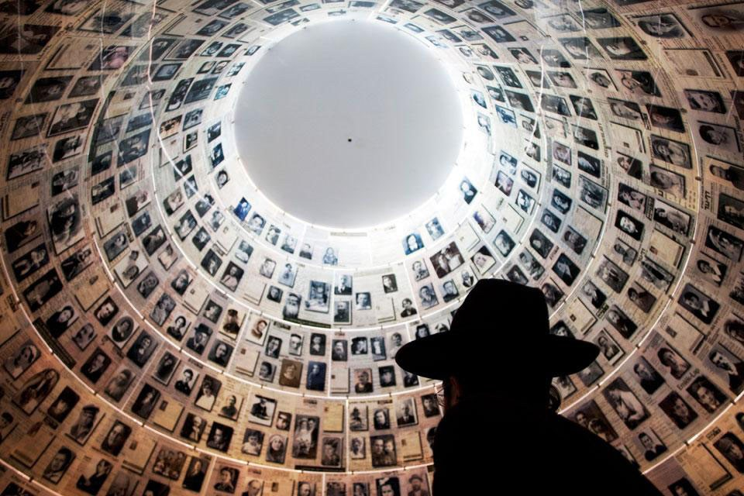
27th January - International Day of Holocaust Remembrance
About 6 million people became victims of the Holocaust. Almost a quarter of them were children. The world has lost
1.5 million worlds, which has not been created by these children.

Slide 15
Teens were not able to tell about their destiny, they left us only occasional diary entries, pictures, notes.
One of these strong people, who wanted to survive and tell their terrible stories to the descendants, was Joseph Y. Butovetsky, a 13-year-old resident of Kirovograd, one of the many million victims of the Holocaust.

Slide 16
The References
http://territoryterror.org.ua/uk/publications/details/?newsid=487
http://akulamedia.com
http://ukrmap.su/uk-wh11/1291.html

