Slide 1
Make the world a better place Ukrainian - Serbian project

Slide 3
Teachers:
Vesna Lučić, Primary school "Stari grad" Užice, Serbia.
Kateryna Tsybulska, Ukraine, Gymnasium “Harmony”, Ukraine.

Slide 4
Steps of a project
Time of realization | Name of activity | Activity | Evaluation
November 2016 | Introducing each other | Post in Facebook group at least one comment or post about yourself, school, town | All participants have one post

Slide 5
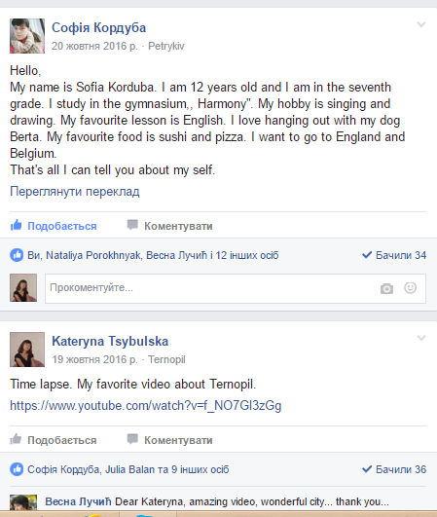

Slide 6
Steps of project
Time of realization | Name of activity | Activity | Evaluation
November 2016. | Return to Rivne: a Holocaust story http://www.centropa.org/centropa-cinema/return-rivne-holocaust-story?language=en | Watch a film and answer the questions: https://docs.google.com/forms/d/16jHNRXuHuUjanFy0zlPzJzyo0e-RQC4ER1zg2fUru8s/edit | All participants have one post
November/ December 2016. | Three promises http://www.centropa.org/centropa-cinema/matilda-kalef-three-promises | Watch a film and answer the questions: https://docs.google.com/forms/d/e/1FAIpQLSdHjUuB1FKjju01aiv9hTVPfapD-ofnkZJemrr6RUU039bcgw/viewform | All participants have one post
December 2016. | Skype conference | Childhood during the war | discussion, family memories about childhood

Slide 7
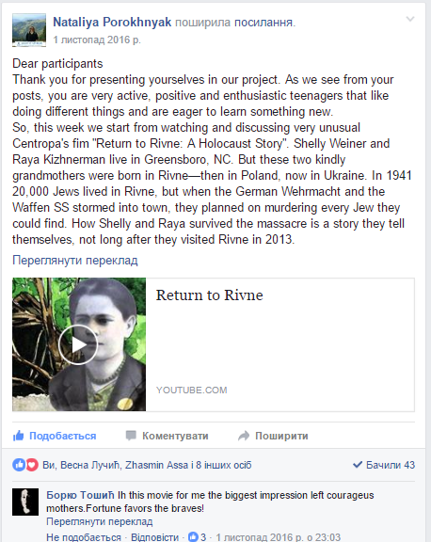

Slide 8
Skype conference
1. Introduction
2. Presentation of our hometowns and countries.
3.The impression of the film
4. „Childhood during the war“: the memories of the main characters of the film, the memories of the student's family members and the memories of the war in modern Ukraine and in Serbia

Slide 9
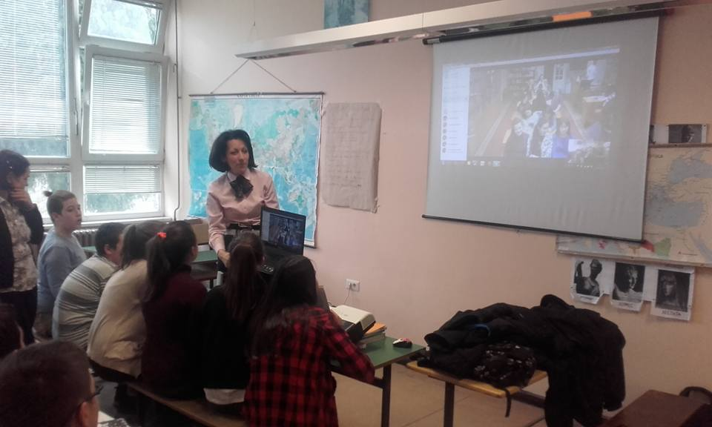
Skype conference

Slide 10
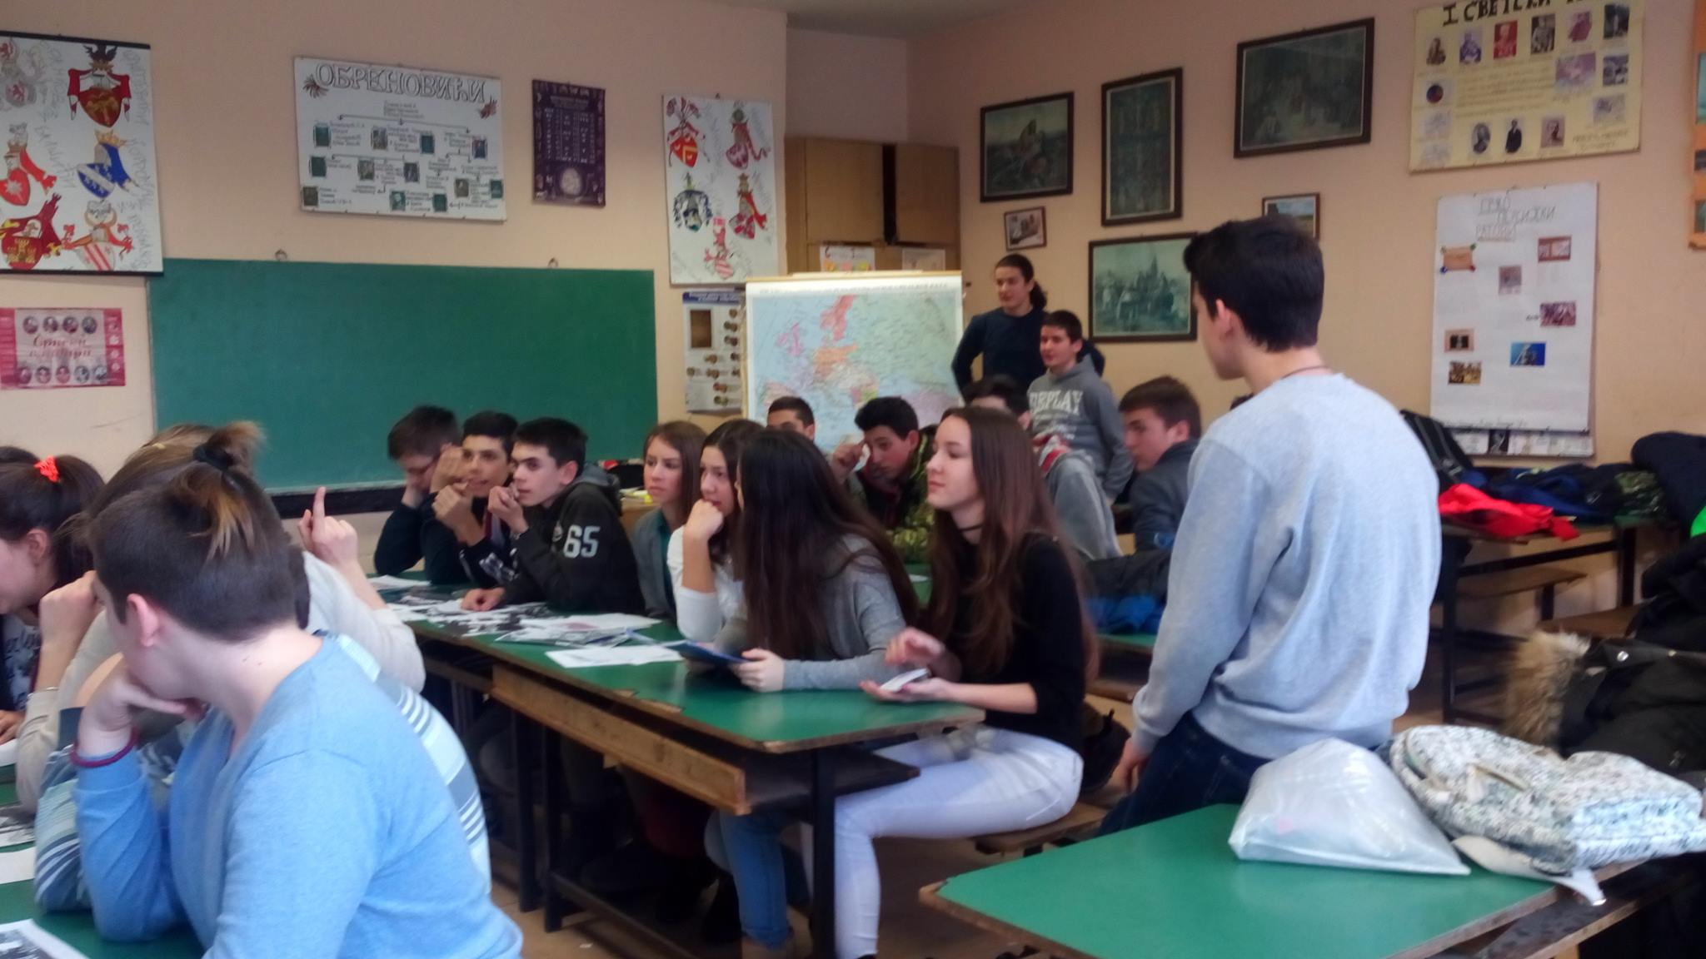
Skype conference

Slide 11
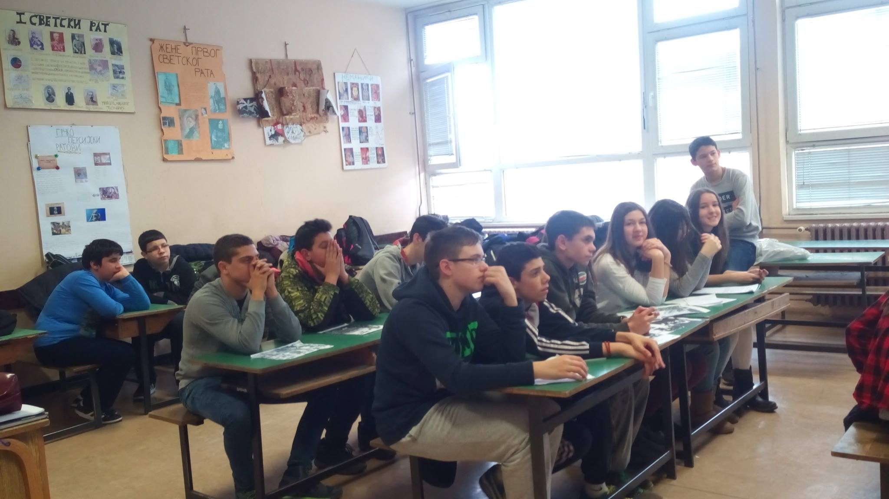
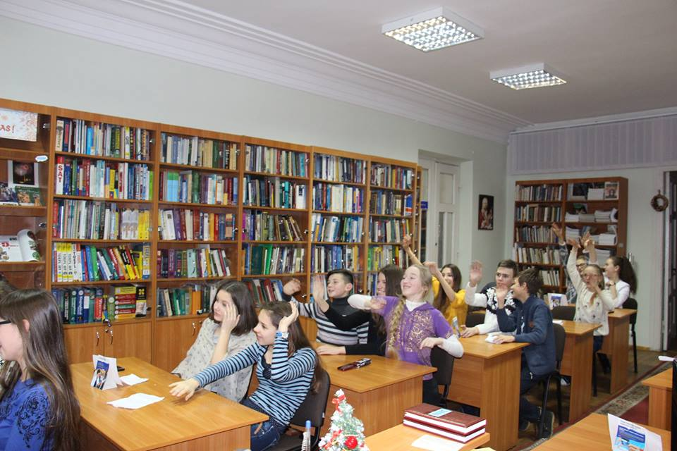

Slide 12
Steps of project
Time of realization | Name of activity | Acitvity | Evaluation
December 2016. | Righteous among the nations | Talking about the Righteous among the Nations? Answer the questions: Are there any Righteous among the Nations in your hometown? Are there people who help others in your school? Town? Country? Give examples. Are you engaged in any volunteer work? | All participants have one post
January 2017. | Messages of peace - our promises to make better world | Students write promises to make this world a better place | All participants have one post
February 2017 | Skype conference | Make the world a better place | Discussion

Slide 13
